Slide 1


International Translation Day
2026
Linguistic Diversity and Language Rights:
The Power of Being Understood

Slide 2
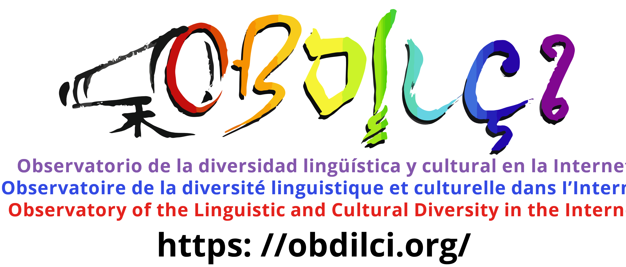
Daniel Pimienta
pimienta@funredes.org
https://obdilci.org
The uncovered reality of today multilingualism of the Internet both a motivation and a concern for Indigenous languages and an alarm call

Slide 3
1-Languages in the Internet
7613 6267 5189 3205 1406 447 125 15 2
Source: Ethnologue 2024 before grouping the macro-languages

Slide 4
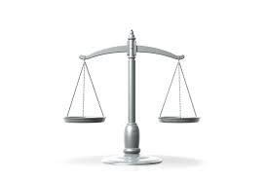
The linguistic paradox
Speakers
LANGUAGES
 | L1>1M | TOTAL
LANGUAGES | 336 | 7 226
% | 4.6% | 100%
L1 | 7 062 906 326 | 7 433 499 219
% | 95.0% | 100%
SPEAKERS L1+L2 | 10 303 359 711 | 10 725 223 758
% | 96.1% | 100%
Multilingualism rate
1.43
Source: Ethnologue 2024 before grouping the macro-languages

Slide 5
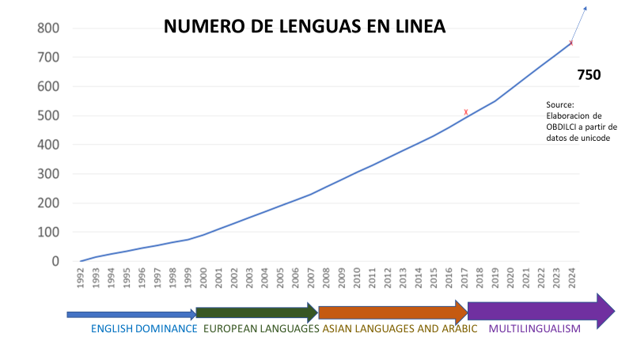
Languages online
NUMBER OF LANGUAGES AVAILABLE ONLINE: ~ 10%
Source: OBDILCI
Elaboration based on
UNICODE data
English European languages Asian languages + Arabic MULTILINGUALISM

Slide 6
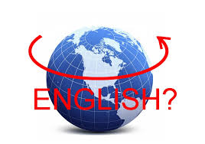
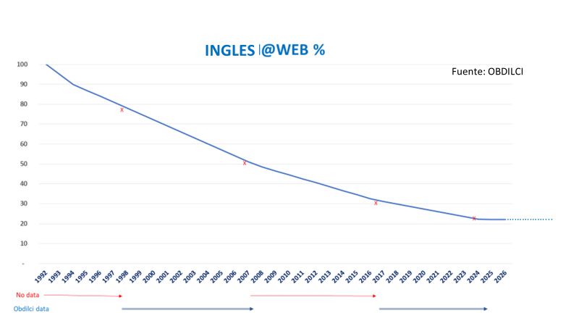
The myth of English as the lingua franca of the Internet
ENGLISH@MEDIA
Source: W3Techs
% ENGLISH @ WEB
SOURCE

Slide 7
CYBER-GEOGRAPHY OF LANGUAGE FAMILIES
Language family | Africa | Americas | Arab | Asia | Europe | Pacific | Not included | TOTAL
% Connected | 36.3% | 69.0% | 68.0% | 60.8% | 89.2% | 62.2% | 49.5% | 64.2%
Contents​ | 4.2% | 0.3% | 3.6% | 44.3% | 45.9% | 0.03% | 1.7% | 100%
Virtual Presence | 0.4 | 0.8 | 0.9 | 0.9 | 1.4 | 0.5 | 0.5 | 1
Content Productivity | 0.6 | 0.8 | 0.8 | 0.9 | 1.2 | 0.7 | 0.7 | 1
Speakers | 11.7% | 0.4% | 4.1% | 48.4% | 32.1% | 0.05% | 3.4% | 100%
% Connected speakers | 6.7% | 0.4% | 4.3% | 47.5% | 38.5% | 0.04% | 2.6% | 100%
Number of languages | 152 | 8 | 1 | 147 | 51 | 2 |  | 361
SOURCES : https://obdilci.org/projects/main/
The method behind the unprecedented production of indicators of the presence of languages in the Internet.
Frontiers Research Metrics & Analytics Volume 8 – 2023. doi: 10.3389/frma.2023.1149347

Slide 8
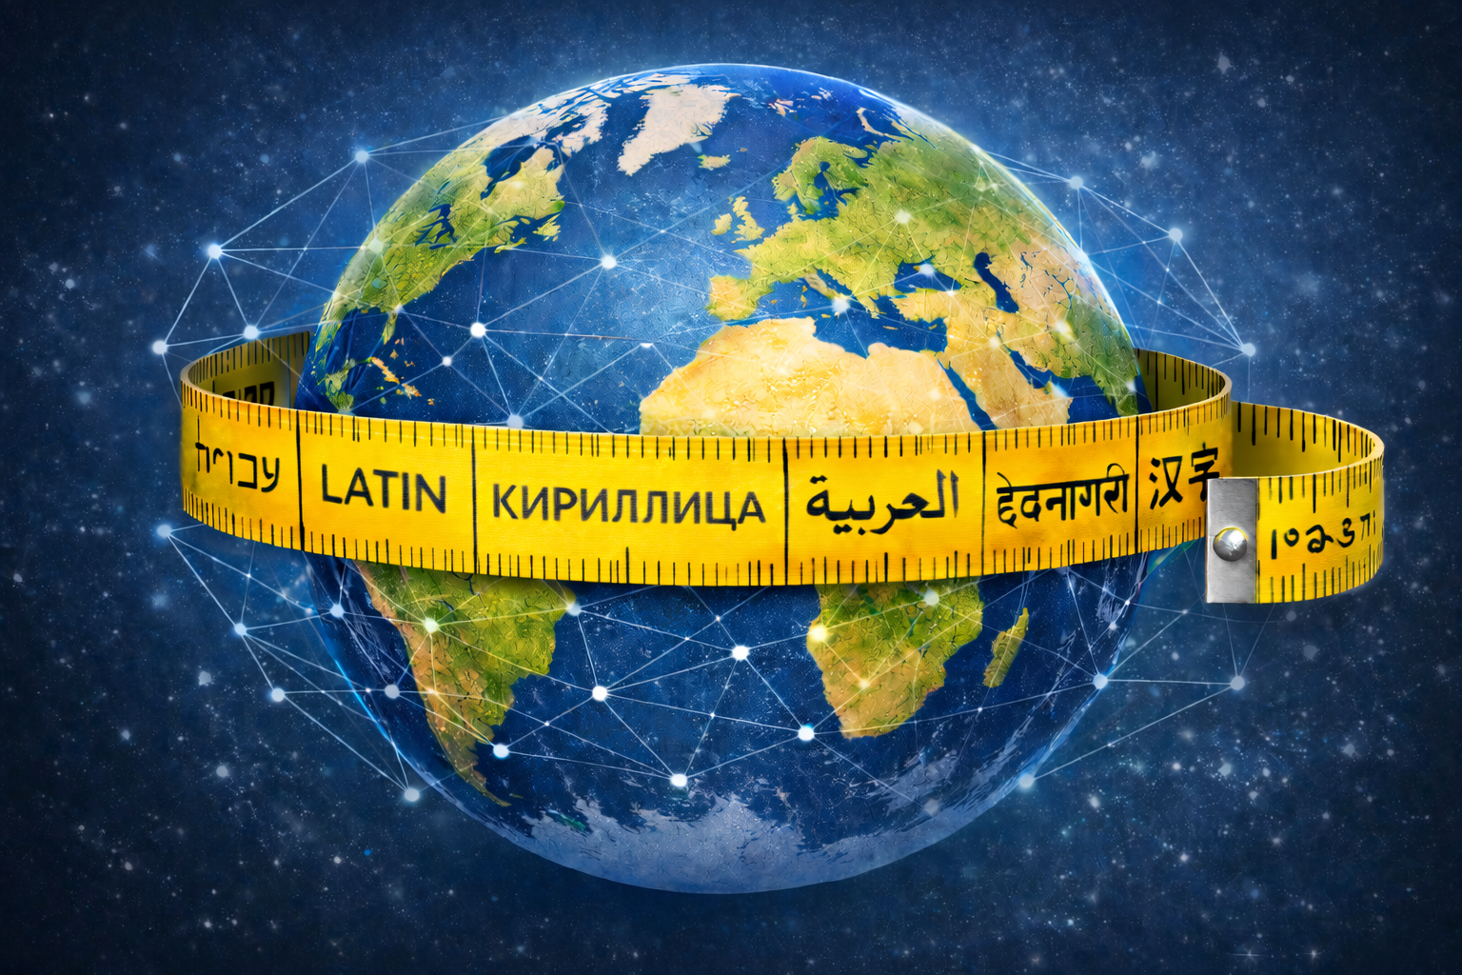
2: Multilingualism in the Internet
FOR THE FIST TIME IN INTERNET HISTORY
INDICATORS OF WEB MULTLINGUALISM
Source 1 (2025): 7 reports using DataProvider.com 180 million web sites data base https://obdilci.org/projects/other/mlreports/
Source 2 (2026): MECILDI program collecting indicators from any series of web sites
https://obdilci.org/projects/mecildi/
https://doi.org/10.13140/RG.2.2.33908.10886

Slide 9
MIXING ALL SOURCES
MULTILINGUALISM AND LANGUAGES
IN WWW
 | ONE MILLION MOST VISITED |  | WHOLE WEB
 | MECILDI MEASURED |  | MODEL + DataProvider ESTIMATIONS
Sites with English version | 67.52% |  | ?
English webpages | 20.13% |  | 20.08%
Multilingualism rate | 3.41 |  | 1.5
%multilingual sites | 37.32% |  | 14.4%
Avg number of lang. per multilingual site | 7.41 |  | 4.5
Google translate | 1.16% |  | ?
IDN | 0.15% |  | ?
Total number of languages (in 100 000 sites) | 318 |  | 750
←

Slide 10
CORRELATION OF MULTILINGUALISM ON THE WEB
COMPARED TO COUNTRIES OR POPULATION
WORLD AVERAGE: 14.4% OF WEB SITES ARE MULTILINGUAL
Indicator : Percentage of multilingual web sites
Low levels of multilingualism in 48% of countries …
BUT
This represents 76% of speakers

Slide 11

MULTILINGUALISM@WEB BY CONTINENT AND REGION
REGION (*) | #WEB | MULTIL%
Arab countries | 417 094 | 43.3%
Europe | 18 987 454 | 17.8%
Asia | 4 424 336 | 8.9%
Latin America and the Caribbean (**) | 2 703 407 | 8.4%
Africa | 1 055 493 | 7.9%
North America | 28 119 411 | 5.2%
Official language: English | 33 291 720 | 5.1%
COUNTRY | MULTIL
USA | 4.8%
CANADA | 13.8%
(*) Based on ccTLD and filtered by hacked domains
(**) Includes Mexico
(***) Includes Australia and New Zealand

Slide 12

LANGUAGES VERSUS MULTILINGUALISM ON THE WEB
LANGUAGE | #WEB | MULTIL
ALL | 95 612 368 | 10.95%
Basque | 8 072 | 63.52%
Ukrainian | 221 043 | 58.67%
Latvian | 43 428 | 53.81%
Catalan | 82 966 | 52.05%
Estonian | 57 245 | 50.89%
Greek | 231 074 | 50.60%
Kazakh | 9 285 | 45.58%
Lao | 1109 | 45.31%
Macedonian | 10 607 | 39.15%
Lithuanian | 91 380 | 38.69%
Sindhi | 9 350 | 35.16%
Slovenian | 86 936 | 34.71%
Bulgarian | 130 100 | 34 24%
Azerbaijani | 21 617 | 32.78%
Tajik | 1 613 | 32.08%
Arabic macro | 332 071 | 31 56%
Welsh | 12 642 | 31 23%
Croatian | 86 665 | 28.95%
Yiddish | 400 | 28.75%
Irish | 2 510 | 26.59%
Bosnian | 119 615 | 26.49%
Amharic | 1 210 | 25.83%
Finnish | 258 164 | 24.56%
Dutch | 1 976 285 | 23.62%
Romanian | 278 962 | 23.36%
Italian | 2 092 445 | 22.84%
Mongolian | 9 289 | 22.28%
Burmese | 3016 | 21.97%
Serbo-Croatian | 11 821 | 21.93%
LANGUAGE | #WEB | MULTIL
English | 52 456 229 | 8.00%
Indonesian | 1 220 050 | 7.94%
Xhosa | 979 | 6.89%
Hausa | 3 237 | 6.72%
Afrikaans | 20 039 | 6.70%
Esperanto | 1 757 | 6.26%
Somali | 2 622 | 6.20%
Haitian | 1 856 | 6.20%
Nepalese | 19 233 | 6.02%
Scottish | 1 408 | 5.86%
Hmm | 1 365 | 5 13%
Luxembourger | 31 987 | 5 12%
Sundanese | 6 099 | 4.34%
Marathi | 33 902 | 4.31%
Japanese | 3 341 482 | 4.16%
Shona | 2 648 | 3.97%
Korean | 596 650 | 3 60%
Javanese | 4 853 | 3 50%
Corsica | 3 353 | 3.43%
Zulu | 2 935 | 2.64%
Samoa | 1061 | 2.59%
Chinese​ | 4 969 986 | 2.08%
Malagasy | 4 225 | 1.78%

Slide 13
COUNTRY (ccTLD ) VERSUS WEB MULTILINGUALISMv
Country_name | Cc TLD | #WEB | MULTIL
ALL |  | 87,199,527 | 14 39%
Monaco | MC | 1069 | 72.03%
Moldova | MD | 15,186 | 70 43%
Kuwait | KW | 1091 | 63.93%
Ukraine | UA | 211,516 | 61 74%
Mauritania | MR | 561 | 60 61%
Luxembourg | LU | 22,859 | 56 86%
Latvia | LV | 46,142 | 54.95%
Georgia | GE | 17,345 | 54 67%
Saudi Arabia | SA | 27,756 | 53.99%
Andorra | AN | 1052 | 53.47%
Armenia | AM | 11,182 | 53 43%
Greece | GR | 243,677 | 53 43%
Jordan | JO | 1,552 | 53.00%
Estonia | EE | 65,173 | 52 12%
Iraq | QI | 3,185 | 51 18%
Greenland | GL | 1062 | 51.08%
Cuba | CU | 358 | 50 28%
Cyprus | CY | 7,704 | 48.94%
Egypt | EG | 2,591 | 48 92%
Yemen | YE | 209 | 47 85%
Bahrain | BH | 1005 | 46 52%
Puerto Rico | PR | 360 | 45 14%
Tajikistan | TJ | 1,633 | 43.94%
Burma | MM | 1052 | 43 73%
Bulgaria | BG | 40,863 | 43 63%
Albania | AL | 11,114 | 43 32%
Oman | OM | 1,796 | 42 73%
North Macedonia | MK | 13,737 | 42 13%
Azerbaijan | AZ | 14,081 | 40 36%
Country_name | Cc TLD | #WEB | MULTIL
Brazil | BR | 1,767,293 | 6.96%
Philippines | PH | 25,248 | 6.87%
Sri Lanka | LK | 21,103 | 6.75%
Indonesia | ID | 265,085 | 6.63%
Barbados | BB | 272 | 6.43%
UNITED STATES | WE | 270,045 | 5.78%
United States (country) | US | 26,955,911 | 4.81%
New Zealand | NZ | 223,600 | 5.55%
Pakistan | PK | 55,940 | 5.43%
Cayman Islands | KY | 1888 | 5.43%
Equatorial Guinea | GQ | 1,286 | 5 25%
Tanzania | TZ | 13,773 | 5.21%
Japan | JP | 900,409 | 5.11%
United Kingdom | UK | 2,178,399 | 4.97%
South Sudan | SS | 151 | 4.97%
India | IN | 903 802 | 4.49%
Falkland Islands | FK | 56 | 4.46%
Kenya | KE | 42,705 | 4.19%
U.S. Virgin Islands | VI | 122 | 4 10%
Sierra Leone | SL | 316 | 3.96%
Australia | AT | 1,121,532 | 3.93%
Bermuda | BM | 1081 | 3 70%
Papua New Guinea | PG | 952 | 3.68%
Nigeria | NG | 59,913 | 3.61%
Bangladesh | BD | 15,848 | 3.52%
Nepal | NP | 32,255 | 3.44%
South Korea | KR | 249,401 | 3.43%
South Africa | ZA | 406,452 | 3.24%
Botswana | BW | 3038 | 3.21%
Lesotho | LS | 803 | 3.11%
China | CN | 861,667 | 2.73%
Zimbabwe | ZW | 13,422 | 2 20%

Slide 14

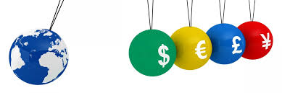
TLD, E-COMMERCE AND ECONOMIC IMPACT VS. MULTILINGUALISM
GROUP | #WEB | MULTIL
ccTLD | 31,498,261 | 14.73%
gTLD | 49,571,411 | 10 88%
New gTLD | 5,521,510 | 8.92%
sTLD | 200,022 | 15 24%
IDN | 87,199,527 | 12 12%
Business | 60 839 086 | 15 63%
Non- Business | 21,532,154 | 3.65%
B2C | 26,589,834 | 16.93%
B2B | 8,971,766 | 18 22%
Online store | 9,761,547 | 25 25%
No online store | 77,437,980 | 10 46%
ECONOMIC IMPACT | #WEB | MULTIPLE
EI > 90 | 110 | 45 45%
80 < EI < 90 | 1111 | 76 51%
70 < EI < 80 | 7,270 | 64 75%
60 < EI < 70 | 40,895 | 56 66%
50 < EI < 60 | 165,685 | 39 78%
40 < EI < 50 | 903,613 | 37 44%
30 < EI < 40 | 4,026,546 | 26 39%
20 < EI < 30 | 17,424,223 | 17 22%
10 < EI < 20 | 51 084 470 | 9 18%
EI < 10 | 4,927,618 | 2.21%
TOTAL/AVG | 78 581 541 | 11.83%

Slide 15
MECILDI FIRST LEARNED LESSONS
A SERIOUS ALARM CALL
The Desert Web of Indigenous, Vernacular, Local, and Minority Languages
https://obdilci.org/wp-content/uploads/2026/09/WebLocal.pdf
I have changed my presentation few days ago after being chocked discovering,
after 50 measurements in websites of ccTLDs and gTLDs,
that the space existing for local languages in most of the case is null or marginal
We have advocate for 30 years about the priority to foster local content
and now that we can measure we discover
that we have failed.
This failure must be solved at a time when IA pose new challenges for languages,
mainly in terms of corpus,
the Web being the first available corpus for IA.

Slide 16
MECILDI FIRST LEARNED LESSONS
A SERIOUS ALARM CALL
MECILDI: A Multilingual-Aware Computational Framework
for Measuring the Language Distribution of Web Content
Extract linguistic diversity indicators from any series of websites.
Example India ccTLD . in
 | %PAGES | %SITES
 | 100.00% | 128.45%
English | 73.00% | 91.83%
Hindi | 3.81% | 4.83%
Vietnamese | 2.04% | 2.61%
Indonesian | 1.53% | 1.96%
Spanish | 1.33% | 1.77%
German | 1.30% | 1.74%
French | 1.19% | 1.60%
Portuguese | 1.04% | 1.39%
Italian | 0.91% | 1.23%
Tamil | 0.79% | 1.05%
Japanese | 0.70% | 0.94%
Chinese | 0.58% | 0.79%
Marathi | 0.55% | 0.71%
Russian | 0.55% | 0.73%
Dutch | 0.53% | 0.75%
Arabic | 0.52% | 0.70%
Polish | 0.44% | 0.62%
Korean | 0.41% | 0.56%
Malayalam | 0.40% | 0.53%
+114 languages | 8.37% | 11.12%
MultiR | 1.28
%Multi | 6.52%
AvgL | 5.39
ERR | 56.20%
ErrG1 | 26.62%
ErrG2-5-6 | 5.83%
ErrG3 | 2.97%
ErrG4 | 10.69%
ErrG7 | 10.09%
GooT | 3.20%
IDN | 0.00%
 | %PAGES | %SITES | % POP
Hindi | 3.81% | 4.83% | 41.86%
Tamil | 0.79% | 1.05% | 5.32%
Marathi | 0.55% | 0.71% | 6.88%
Malayalam | 0.40% | 0.53% | 2.48%
Bengali | 0.36% | 0.48% | 7.41%
Telugu | 0.29% | 0.40% | 6.53%
Gujarati | 0.27% | 0.37% | 4.17%
Kannada | 0.24% | 0.34% | 4.07%
Urdu | 0.14% | 0.20% | 4.40%
Panjabi | 0.13% | 0.19% | 2.36%
Oriya | 0.07% | 0.09% | 2.64%
TOTAL | 7.05% | 9.18% | 88.13%
Multilingualism indicators
Local languages elaboration
Languages distribution

Slide 17
MECILDI FIRST LEARNED LESSONS
A SERIOUS ALARM CALL
The Desert Web of Indigenous, Vernacular, Local, and Minority Languages
Some examples
Guarani: official language of Paraguay, spoken by 88% - 0.26% of .pa websites
80% of Haitian population only understand Creole, e.g. access to less than 8% of .ht websites.
Papiamentu: spoken by +90% in Curacao - 10% of webpages
Kabuverdianu: 80% Cabo Verde speakers - one website.
Everybody speaks Rundi in Burundi except the web (1% of websites)
Hindi, Tamil, Marathi, Malayalam, Bengali, Telugu, Gujarati, Kannada, Urdu, Panjabi and Oriya represent together 88% of India population and 7% of webpages in ccTLD .in

Slide 18
MECILDI FIRST LEARNED LESSONS
A SERIOUS ALARM CALL
LANGUAGES | ISO 639 | DOMAIN | PLACE | %speakers | L1+L2 | %PAGES | %SITES | WRATE
Basque | eus | .eus | Pays Basque | 36% | 1M | 36.37% | 94.02% | 2.612
Catalan | cat | .ad | Andorra | 37% | 30900 | 20.75% | 61.68% | 1.672
Breton | bre | .bzh | Bretagne | 5% | 200K (World) | 2.91% | 2.19% | 0.438
Luxemburgish | ltz | .lu | Luxemburg | 55% | 365K | 4.20% | 12.80% | 0.232
Malayalam | mal | .in | India | 3% | 36M | 0.40% | 0.53% | 0.212
Papiamentu | pap | .cw | Cuaracao | 92% | 136K | 11.52% | 18.47% | 0.201
Tamil | tam | .in | India | 5% | 76M | 0.79% | 1.05% | 0.199
Tahitian | tah | .pf | French Polynesia | 19% | 56K | 1.69% | 2.67% | 0.144
Malagasy | mlg | .mg | Madagascar | 58% | 18M | 4.61% | 7.58% | 0.131
Hindi | hin | .in | India | 42% | 611M | 3.81% | 4.83% | 0.114
Corsican | cos | .corsica | Corsica | 35% | 120K (World) | 3.55% | 3.68% | 0.105
Marathi | mar | .in | India | 7% | 99M | 0.55% | 0.71% | 0.103
Gujarati | guj | .in | India | 4% | 60M | 0.27% | 0.37% | 0.090
Haitian Creole | hat | .ht | Haiti | 95% | 13.8M (World) | 3.41% | 7.89% | 0.083
Kannada | kan | .in | India | 4% | 58.5M | 0.24% | 0.34% | 0.082
Bengali | ben | .in | India | 7% | 107M | 0.36% | 0.48% | 0.064
Telugu | tel | .in | India | 7% | 94M | 0.29% | 0.40% | 0.061
Urdu | urd | .in | India | 4% | 63M | 0.14% | 0.20% | 0.049
Bislama | bis | .vu | Vanuatu | 34% | 115K (World) | 0.99% | 1.60% | 0.047
Panjabi | pan | .in | India | 4% | 34M | 0.13% | 0.19% | 0.045
Oriya | ori | .in | India | 3% | 37M | 0.07% | 0.09% | 0.036
Swahili | swc | .cd | Dem. Rep. Congo | 25% | 32M | - | 0.53% | 0.021
THE INDICATOR
WRATE =
%SPEAKERS
divided by
% WEBSITES
>1 Good
=1 Fair
<0.5 Weak
<0.1 Very weak

Slide 19
MECILDI FIRST LEARNED LESSONS
A SERIOUS ALARM CALL
LANGUAGES | ISO 639 | DOMAIN | PLACE | %speakers | L1+L2 | %PAGES | %SITES | WRATE
Yiddish | yid | .il | Israel | 5% | 443K (World) | 0.02% | 0.03% | 0.006
Rundi | run | ,bi | Burundi | 98% | 13M (World) | - | 0.56% | 0.006
Guarani | grn | .py | Paraguay | 88% | 6M | 0.13% | 0.26% | 0.003
Quechua | que | .pe | Peru | 21% | 7.3M | 0.04% | 0.06% | 0.003
Créole guadeloupeén | gcf | .gp | Guadeloupe | 95% | 375K | 0.07% | 0.18% | 0.002
Tamazight | zgh | .ma | Maroc | 25% | 9M | - | 0.04% | 0.002
Kabuverdianu | kea | .cv | Cabo Verde | 82% | 492K | ε | ε | 0.000
Ladino | lad | .il | Israel | 0% | 43K | ε | ε | 0.000
Alsatian | gsw | .alsace | Alsace | 35% | 900K (France) | 0 | 0 | 0
Aymara | aym | .bo | Bolivia | 14% | 1.7M | 0 | 0 | 0
Chokwe | cjk | .ao | Angola | 7% | 2.4M | 0 | 0 | 0
French Creole | acf | .lc | St Lucia | 77% | 138K | 0 | 0 | 0
Hassaniyya | mey | .mr | Mauritania | 82% | 4M | 0 | 0 | 0
Jula | dyu | .ci | Côte d'Ivoire | 27% | 8.5M | 0 | 0 | 0
Kanak languages |  | .nc | Nouv. Calédonie | 36% | 71K | 0 | 0 | 0
Kikongo | kwy | .ao | Angola | 8% | 3M | 0 | 0 | 0
Kimbundu | kmb | .ao | Angola | 5% | 1.7M | 0 | 0 | 0
Martinique Creole | acf | .mq | Martinique | 98% | 360K | 0 | 0 | 0
Monegasque | lij | .mc | Monaco | 22% | 8000 | 0 | 0 | 0
Umbundu | umb | .ao | Angola | 23% | 8.5M | 0 | 0 | 0
THE INDICATOR
WRATE =
%SPEAKERS
divided by
% WEBSITES
<0.01 Marginal
< 0.001 Terrible
= 0 How come?

Slide 20
FOCUS MULTILINGUAL WEB SITES@TRANCO
 | %PAGES | %SITES
TOTAL | 100.00% | 715.60%
English | 12.66% | 90.58%
German | 7.26% | 51.94%
French | 7.24% | 51.81%
Spanish | 6.63% | 47.48%
Italian | 4.87% | 34.82%
Portuguese | 4.13% | 29.55%
Dutch | 3.75% | 26.81%
Russian | 3.05% | 21.83%
Polish | 2.96% | 21.18%
Japanese | 2.86% | 20.50%
Chinese | 2.71% | 19.38%
Swedish | 2.08% | 14.88%
Korean | 2.03% | 14.53%
Turkish | 1.93% | 13.78%
Arabic | 1.92% | 13.76%
Czech | 1.80% | 12.88%
Danish | 1.72% | 12.30%
Indonesian | 1.68% | 12.02%
Finnish | 1.60% | 11.43%
Romanian | 1.49% | 10.70%
Hungarian | 1.48% | 10.62%
OTHERL | 1.45% | 10.39%
Ukrainian | 1.40% | 10.00%
More than 90% of multilingual sites have an English version
However less tan 13% of web pages are in English
No contradiction here: there are 7.16 languages avg per site
Around 50% sites have German, French and Spanish versión
Around 1/3 sites have Italian & Portuguese versión
Between 1/4 and 1/5 sites have Dutch, Russian, Polish, Japanese and Chinese versión.
13% is close to the percentage of L1+L2 speakers amongst total world L1+L2 speakers. (Source Ethnologue 2024 : 14.13% = 1.515 B/ 10.72B)
YES THE WEB IS MORE AND MORE MULTILINGUAL
BUT THIS FAVORS A SUBSET OF LANGUAGES
THIS IS NOT ONLY A QUESTION OF RIGHTS
IT IS ALSO A QUESTION OF ECONOMIC RATIONAL!!!

Slide 21

3: AI and digital languages

Slide 22
AI AND LINGUISTIC DIVERSITY ON THE INTERNET
The internet is now the most multilingual space ever created.
The lingua franca of the internet is not English, but translation boosted by IA
WE ARE LIVING THROUGH A REVOLUTION IN THE FIELD OF TRANSLATION
AI
AND THE BEGINNING OF A PARADIGM SHIFT WITH LANGUAGES:
FROM INTERCOMPREHENSION SUPPORT TO AI-ASSISTED TRANSLATION
Augmented intelligence
HOWEVER
THE CHALLENGE OF INTEGRATING MINORITY LANGUAGES REMAINS IMMENSE
MORE THAN 95% OF LANGUAGES = LESS THAN 5% OF SPEAKERS…

Slide 23
WHAT ABOUT INDIGENOUS LANGUAGES?
WHAT DO WE DO WITH THE THOUSANDS OF LANGUAGES LEFT BEHIND, THE INDIGENOUS LANGUAGES?
UNDERSTANDING THAT PARTICIPATING IN DIGITAL LIFE SHOULD BE A LINGUISTIC RIGHT
UNDERSTANDING THE PARADOXICAL ECONOMIC EQUATION
MOTIVATING LANGUAGE FAMILIES TO UNITE TO MEET THE CHALLENGE:
ALGIC: 56 languages, less than 25,000 inhabitants. Together, more than 150,000 (Canada and United States).
ESKIMO: 21 languages (Canada, USA, Greenland, Russia)
EYAK-ATHABASKAN: 47 languages, including Navajo and Apache, totaling over 200,000 (Canada, United States)
MAYA: 20 languages > 2.5 million
OTO-MANGUEAN: 148 languages, including Mixtec and Zapotec, totaling > 1.7 million
UTO-AZTECAN: 48 languages like Nahuatl, totaling > 1.9 million
TUPIAN: 63 languages in Brazil, totaling > 75,000, closely related to Guarani (official language of Paraguay)

Slide 24
LEVELS OF
LANGUAGE DIGITIZATION
LLM
20?
CORPUS
50?
DISCOVERABILITY
100?
CONTENTS
343 Wikipedia
TECHNOLOGICAL SUPPORT
250 Google Translate
DIGITAL EXISTENCE (UNICODE)
750 OBDILCI estimate
7500

Slide 25
REFERENCES
REFERENCES
Pimienta, D., 2022. Resource: Indicators on the presence of languages in the Internet . Proceedings of the 1st Annual Meeting of the ELRA/ISCA Interest Group on Underfunded Languages; June 24-25, 2022; Marseille, France. pp. 83–91. https://aclanthology.org/2022.sigul-1.11/
French version: https://obdilci.org/wp-content/uploads/2024/01/Res.Ind_.lang_.Internet.fr_.pdf
Pimienta, D., Blanco, A., Müller de Oliveira, G., 2023. The method behind the unprecedented production of indicators of the presence of languages in the Internet , Frontiers in Research Metrics and Analytics. Flight. 8 - https://doi.org/10.3389/frma.2023.1149347 -
Pimienta, D. 2024 . Is it true that more than half the Web contents are in English? If Web multilingualism is paid due attention then no! Forum for Linguistic studies, Vol. 6, Iss. 5 - https://doi.org/10.30564/fls.v6i5.7144
French version : https://obdilci.org/wp-content/uploads/2024/11/FLS-7144-6-5.en_.fr_.docx
Pimienta, D. 2025. Inventory and comparisons of all methods for the measurement of languages online and implications on Internet's lingua franca , LT4ALL2025, Paris-UNESCO , https://obdilci.org/wp-content/uploads/2025/01/LangOnlineReport.do cx
Pimienta, D. 2026. Linguistic diversity on the Internet in "From Babel to Artificial Intelligence – Multilingualism from Dante to the Present Day , " Christian Tremblay, José Carlos Herreras ( eds .). Multilingualism Collection, published by the European Observatory of Multilingualism. ISBN: 9791042488130 – 1/2026 - https://obdilci.org/wp-content/uploads/2026/01/BabelIA-DLI.pdf
Pimienta D., Field M., 2026. MECILDI: computing languages and multilingualism indicators of any series of web sites with due attention to web multilingualism - Application on TRANCO and comparation with W3Techs, Preprint https://doi.org/10.13140/RG.2.2.33908.10886

