Slide 1
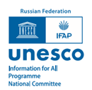


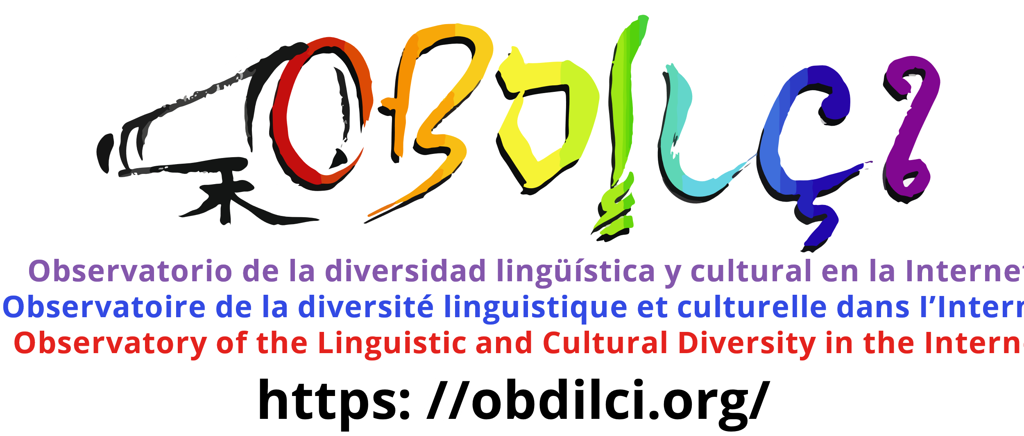
VIII International Conference
‘Tangible and Intangible Impact of Information and Communication
in the Digital Age’
(June 17–19, 2026, Khanty-Mansiysk, Russian Federation)
Plenary session ‘Linguistic and Cultural Diversity: Challenges and Opportunities of the Digital Age’
Multilingualism on the Internet :
state of the art and perspectives
Daniel Pimienta, pimienta@funredes.org
President of the Observatory of Linguistic and Cultural Diversity on the Internet.

Slide 2

1: Languages In the Internet

Slide 3
7613 6267 5189 3205 1406 447 125 15 2
Source: Ethnologue 2024, before grouping the macro-languages

Slide 4

The linguistic paradox
LANGUAGES
Speakers
 | L1>1M | TOTAL
LANGUAGES | 336 | 7,226
% | 4.6% | 100%
L1 | 7,062,906,326 | 7,433,499,219
% | 95.0% | 100%
SPEAKERS L1+L2 | 10,303,359,711 | 10,725,223,758
% | 96.1% | 100%
Multilingualism rate
1.43
Source: Ethnologue 2024, before grouping the macro-languages

Slide 5
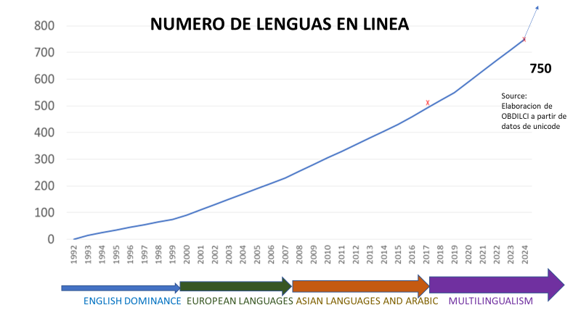
The linguistic paradox
NUMBER OF LANGUAGES AVAILABLE ONLINE: ~ 10%
Source: OBDILCI
Elaboration based on
UNICODE data
English European languages Asian languages + Arabic MULTILINGUALISM

Slide 6
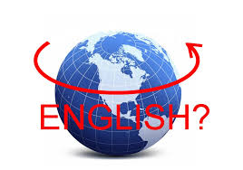
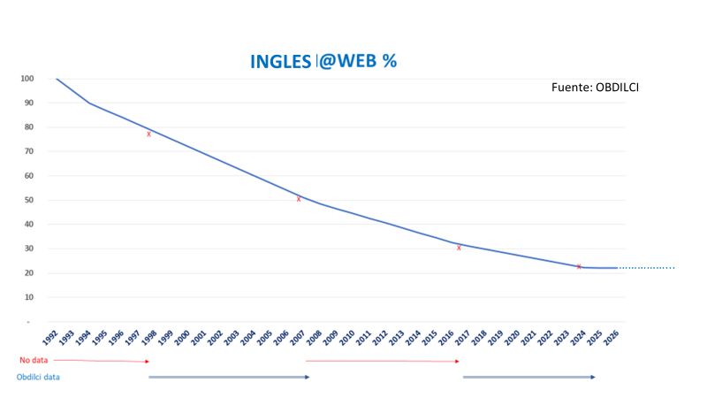
The myth of English as the lingua franca of the Internet
ENGLISH@MEDIA
Source: W3Techs
% ENGLISH @ WEB
SOURCE:

Slide 7
CYBER-GEOGRAPHY OF LANGUAGE FAMILIES
Language family | Africa | Americas | Arab | Asia | Europe | Pacific | Not included | TOTAL
% Connected | 36.3% | 69.0% | 68.0% | 60.8% | 89.2% | 62.2% | 49.5% | 64.2%
Contents​ | 4.2% | 0.3% | 3.6% | 44.3% | 45.9% | 0.03% | 1.7% | 100%
Virtual Presence | 0.4 | 0.8 | 0.9 | 0.9 | 1.4 | 0.5 | 0.5 | 1
Content s | 0.6 | 0.8 | 0.8 | 0.9 | 1.2 | 0.7 | 0.7 | 1
Speakers | 11.7% | 0.4% | 4.1% | 48.4% | 32.1% | 0.05% | 3.4% | 100%
% Connected speakers | 6.7% | 0.4% | 4.3% | 47.5% | 38.5% | 0.04% | 2.6% | 100%
Number of languages | 152 | 8 | 1 | 147 | 51 | 2 |  | 361

Slide 8
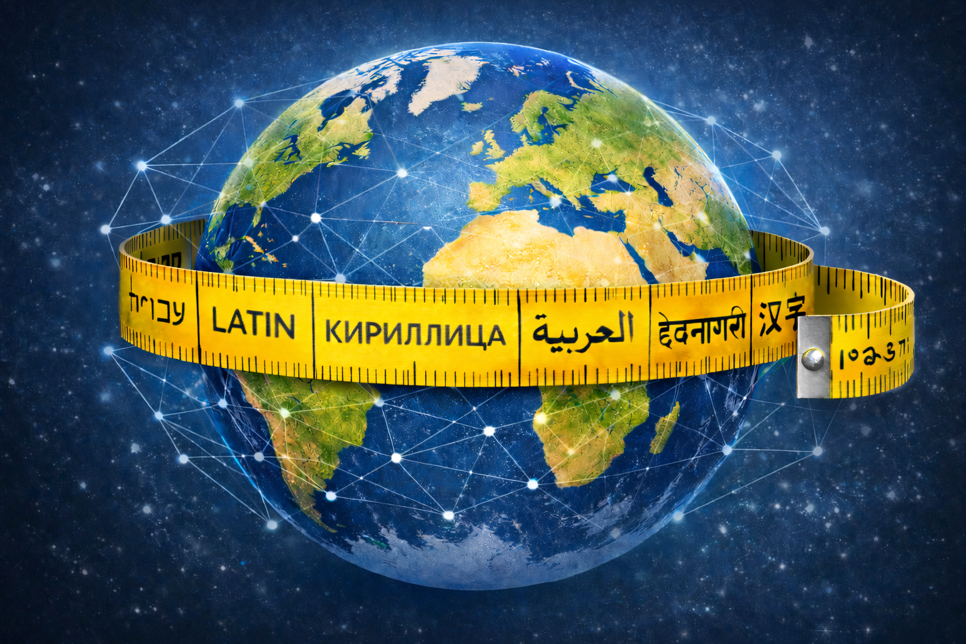
2: Multilingualism in the Internet

Slide 9


THE REALITY OF MULTILINGUALISM ON THE INTERNET IS BOTH:
THE CAUSE OF THE HUGE BIAS IN LINGUISTIC DATA ON THE INTERNET
THE INTERNET 'S BEST-HIDDEN SECRET
OBDILCI SUCCEEDED IN 2025 and 2026 IN LAUNCHING RESEARCH ON THIS SUBJECT:
THE RESULTS ARE APPROXIMATE
HOWEVER, THEY ARE SIGNIFICANT AND ALLOW US TO SHOW A FIRST IMAGE CHARACTERIZED BY
  VERY GREAT VARIATION DEPENDING ON COUNTRIES AND LANGUAGES
  In any case, the figures are quite high on average , and it's a rapid growth model.
  A CONCLUSION THAT THE INTERNET COULD BE (OR SOON BECOME) THE MOST MULTILINGUAL PLACE
  HAVING NEVER EXISTED ON EARTH.
SOURCES: 2025, DATAPROVIDER.COM DATABASE + 2026, MECILDI/OBDILCI

Slide 10

OBDILCI 2025 RESEARCH ON MULTILINGUALISM ON THE INTERNET
https://www.obdilci.org/projects/other/mlreports/
The state of multilingualism on the WWW
L’état de multilinguisme de la Toile, rapport technique #7: Propension à l’utilisation de la langue française dans l’écosystème Web des ccTLDs d’Afrique francophone. 10/2025
Technical Report #6: Wikimedia multilingualism, 9/2025
Technical Report #5: Web Multilingualism analyzed by ccTLD languages gTLDs and much more: winners and losers, 8/2025
Informe No 4: Una evaluación de la reciprocidad en el uso mutuo del español y del portugués en la web lusófona e hispanófona. 6/2025
Rapport Rapport technique #3 : Une caractérisation du Web francophone à partir d’une série de paramètres en comparaison avec d’autres langues dominantes sur la Toile. 5/2025
Technical Report #2: Exploring web presence and multilingualism of European minority languages with associated gTLDs. 4/2025
Technical Report #1: Approximation of the Rate of multilingualism of the WWW 2/2025 En français.

Slide 11
CORRELATION OF MULTILINGUALISM ON THE WEB
COMPARED TO COUNTRIES OR POPULATION
Indicator : Percentage of multilingual web sites
Low levels of multilingualism in 48% of countries …
BUT
This represents 76% of speakers

Slide 12

MULTILINGUALISM@WEB BY CONTINENT AND REGION
REGION (*) | #WEB | MULTIL%
Europe | 18,987,454 | 17.8%
North America | 28,119,411 | 5.2%
Latin America and the Caribbean (**) | 2,703,407 | 8.4%
Africa | 1,055,493 | 7.9%
Oceania (***) | 1,350,548 | 4.3%
Arab countries | 417,094 | 43.3%
Asia | 4,424,336 | 8.9%
Official language: English | 33,291,720 | 5.1%
COUNTRY | MULTIL
USA | 4.8%
CANADA | 13.8%
(*) Based on ccTLD and filtered by hacked domains
(**) Includes Mexico
(***) Includes Australia and New Zealand

Slide 13

LANGUAGES VERSUS MULTILINGUALISM ON THE WEB
LANGUAGE | #WEB | MULTIL
ALL | 95,612,368 | 10 95%
Basque | 8072 | 63 52%
Ukrainian | 221,043 | 58 67%
Latvian | 43,428 | 53 81%
Catalan | 82,966 | 52.05%
Estonian | 57,245 | 50 89%
Greek | 231,074 | 50-60%
Kazakh | 9,285 | 45 58%
Lao | 1109 | 45 31%
Macedonian | 10,607 | 39 15%
Lithuanian | 91,380 | 38 69%
Sindhi | 9,350 | 35 16%
Slovenian | 86,936 | 34 71%
Bulgarian | 130 100 | 34 24%
Azerbaijani | 21,617 | 32 78%
Tajik | 1,613 | 32.08%
Arabic macro | 332,071 | 31 56%
Welsh | 12,642 | 31 23%
Croatian | 86,665 | 28.95%
Yiddish | 400 | 28 75%
Irish | 2,510 | 26 59%
Bosnian | 119,615 | 26 49%
Amharic | 1,210 | 25 83%
Finnish | 258,164 | 24 56%
Dutch | 1,976,285 | 23 62%
Romanian | 278,962 | 23 36%
Italian | 2,092,445 | 22 84%
Mongolian | 9,289 | 22 28%
Burmese | 3016 | 21.97%
Serbo-Croatian | 11,821 | 21.93%
LANGUAGE | #WEB | MULTIL
English | 52,456,229 | 800%
Indonesian | 1,220,050 | 7.94%
Xhosa | 979 | 6.89%
Hausa | 3,237 | 6.72%
Afrikaans | 20,039 | 6 70%
Esperanto | 1,757 | 6.26%
Somali | 2,622 | 6 20%
Haitian | 1,856 | 6 20%
Nepalese | 19,233 | 6.02%
Scottish | 1,408 | 5.86%
Hmm | 1,365 | 5 13%
Luxembourger | 31,987 | 5 12%
Sundanese | 6,099 | 4.34%
Marathi | 33,902 | 4.31%
Japanese | 3,341,482 | 4.16%
Shona | 2,648 | 3.97%
Korean | 596,650 | 3 60%
Javanese | 4,853 | 3 50%
Corsica | 3,353 | 3.43%
Zulu | 2,935 | 2.64%
Samoa | 1061 | 2.59%
Chinese​ | 4,969,986 | 2.08%
Malagasy | 4,225 | 1.78%

Slide 14
COUNTRY (ccTLD ) VERSUS WEB MULTILINGUALISM
Country_name | ccTLD | #WEB | MULTIL
ALL |  | 87,199,527 | 14 39%
Monaco | MC | 1069 | 72.03%
Moldova | MD | 15,186 | 70 43%
Kuwait | KW | 1091 | 63.93%
Ukraine | UA | 211,516 | 61 74%
Mauritania | MR | 561 | 60 61%
Luxembourg | LU | 22,859 | 56 86%
Latvia | LV | 46,142 | 54.95%
Georgia | GE | 17,345 | 54 67%
Saudi Arabia | SA | 27,756 | 53.99%
Andorra | AN | 1052 | 53.47%
Armenia | AM | 11,182 | 53 43%
Greece | GR | 243,677 | 53 43%
Jordan | JO | 1,552 | 53.00%
Estonia | EE | 65,173 | 52 12%
Iraq | QI | 3,185 | 51 18%
Greenland | GL | 1062 | 51.08%
Cuba | CU | 358 | 50 28%
Cyprus | CY | 7,704 | 48.94%
Egypt | EG | 2,591 | 48 92%
Yemen | YE | 209 | 47 85%
Bahrain | BH | 1005 | 46 52%
Puerto Rico | PR | 360 | 45 14%
Tajikistan | TJ | 1,633 | 43.94%
Burma | MM | 1052 | 43 73%
Bulgaria | BG | 40,863 | 43 63%
Albania | AL | 11,114 | 43 32%
Oman | OM | 1,796 | 42 73%
North Macedonia | MK | 13,737 | 42 13%
Azerbaijan | AZ | 14,081 | 40 36%
Lithuania | LT | 84,366 | 39.94%
San Marino | SM | 580 | 39 22%
Cambodia | KH | 1,305 | 38 89%
Hong Kong | HK | 47,269 | 38 59%
Portugal | PT | 152,372 | 36 51%
Panama | PA | 2,654 | 35 80%
Slovenia | SI | 68,650 | 34.98%
Croatia | HR | 68,411 | 34 49%
Country_name | ccTLD | #WEB | MULTIL
Brazil | BR | 1,767,293 | 6.96%
Philippines | PH | 25,248 | 6.87%
Sri Lanka | LK | 21,103 | 6.75%
Indonesia | ID | 265,085 | 6.63%
Barbados | BB | 272 | 6.43%
UNITED STATES | WE | 270,045 | 5.78%
United States (country) | US | 26,955,911 | 4.81%
New Zealand | NZ | 223,600 | 5.55%
Pakistan | PK | 55,940 | 5.43%
Cayman Islands | KY | 1888 | 5.43%
Equatorial Guinea | GQ | 1,286 | 5 25%
Tanzania | TZ | 13,773 | 5.21%
Japan | JP | 900,409 | 5.11%
United Kingdom | UK | 2,178,399 | 4.97%
South Sudan | SS | 151 | 4.97%
India | IN | 903 802 | 4.49%
Falkland Islands | FK | 56 | 4.46%
Kenya | KE | 42,705 | 4.19%
U.S. Virgin Islands | VI | 122 | 4 10%
Sierra Leone | SL | 316 | 3.96%
Australia | AT | 1,121,532 | 3.93%
Bermuda | BM | 1081 | 3 70%
Papua New Guinea | PG | 952 | 3.68%
Nigeria | NG | 59,913 | 3.61%
Bangladesh | BD | 15,848 | 3.52%
Nepal | NP | 32,255 | 3.44%
South Korea | KR | 249,401 | 3.43%
South Africa | ZA | 406,452 | 3.24%
Botswana | BW | 3038 | 3.21%
Lesotho | LS | 803 | 3.11%
China | CN | 861,667 | 2.73%
Zimbabwe | ZW | 13,422 | 2 20%

Slide 15


TLD, E-COMMERCE AND ECONOMIC IMPACT VS. MULTILINGUALISM
GROUP | #WEB | MULTIL
ccTLD | 31,498,261 | 14.73%
gTLD | 49,571,411 | 10 88%
New gTLD | 5,521,510 | 8.92%
sTLD | 200,022 | 15 24%
IDN | 87,199,527 | 12 12%
Business | 60 839 086 | 15 63%
Non- Business | 21,532,154 | 3.65%
B2C | 26,589,834 | 16.93%
B2B | 8,971,766 | 18 22%
Online store | 9,761,547 | 25 25%
No online store | 77,437,980 | 10 46%
ECONOMIC IMPACT | #WEB | MULTIPLE
EI > 90 | 110 | 45 45%
80 < EI < 90 | 1111 | 76 51%
70 < EI < 80 | 7,270 | 64 75%
60 < EI < 70 | 40,895 | 56 66%
50 < EI < 60 | 165,685 | 39 78%
40 < EI < 50 | 903,613 | 37 44%
30 < EI < 40 | 4,026,546 | 26 39%
20 < EI < 30 | 17,424,223 | 17 22%
10 < EI < 20 | 51 084 470 | 9 18%
EI < 10 | 4,927,618 | 2.21%
TOTAL/AVG | 78 581 541 | 11.83%

Slide 16

MAIN CONCLUSIONS
High web multilingualism is correlated with: e-commerce, strong economic footprint, European countries, Arab countries.
Low multilingualism on the Web is correlated with English-speaking countries and some Asian countries (China, South Korea, India, Japan, Indonesia).
Low multilingualism on the Web in 48% of countries representing 76% of speakers
Linguistic winners: Basque, Ukrainian, Latvian, Catalan, Estonian and Greek
The linguistic losers: Chinese, Korean and Japanese
Winners in the national categories: Monaco, Moldova, Kuwait, Ukraine and Mauritania
Losers in the national domains : Zimbabwe, China , South Africa, South Korea
Urban domain winners : Montreal, Kyiv, Barcelona, Brussels, Hamburg, Lisbon
Losers in the municipal domain: Los Angeles, New York, Houston, Moscow, Tokyo
TLD winners: most language and geographic gTLDs, ccTLDs, business-oriented sites
The losers of the TLDs: the remaining gTLD sites, non-business-oriented sites
Unique feature: Luxembourg's population is very high, but the Luxembourger population is very low.
An unusual feature: Portuguese is low despite Portugal being high because Brazil is very low.
Unique feature: North America is weak despite an average Canada because the United States is very weak

Slide 17
OBDILCI 2026 : MECILDI A NEW PROGRAM
WITH THE CAPACITY TO EXTRACT LINGUISTIC INDICATORS
FROM ANY SERIES OF WEB SITES (LESS THAN 5 MILLION)
https://obdilci.org/projects/mecildi/
Pimienta D., Field M., 2026. MECILDI: computing languages and multilingualism indicators of any series of web sites with due attention to web multilingualism - Application on TRANCO and comparation with W3Techs, Preprint https://doi.org/10.13140/RG.2.2.33908.10886

Slide 18
MECILDI :
A NEW PROGRAM WITH THE CAPACITY TO EXTRACT LANGUAGES AND MULTILINGUALISM
INDICATORS TO ANY SERIES OF WEB SITES BELOW FEW MILLIONS
MECILDI FIRST RESULTS
FIRST RESULTS : APPLICATION TO TRANCO SERIES OF ONE MILLON MOST VISITED WEBSITES
 | %PAGES | %SITES
TOTAL | 100.00% | 191.56%
English | 20.89% | 58.74%
German | 6.58% | 11.19%
French | 6.29% | 9.82%
Spanish | 6.25% | 10.78%
Italian | 4.05% | 6.08%
Portuguese | 3.90% | 6.89%
Russian | 3.54% | 8.30%
Dutch | 3.23% | 5.06%
Japanese | 2.97% | 5.99%
Chinese | 2.86% | 5.86%
Polish | 2.70% | 4.38%
Swedish | 1.89% | 2.78%
Indonesian | 1.84% | 3.64%
Turkish | 1.76% | 3.19%
Korean | 1.72% | 2.77%
Arabic | 1.71% | 2.64%
Czech | 1.58% | 2.52%
Danish | 1.45% | 2.14%
Finnish | 1.39% | 1.98%
Ukrainian | 1.28% | 1.93%
Hungarian | 1.26% | 1.89%
Modern Greek | 1.24% | 1.86%
Romanian | 1.24% | 1.94%
Vietnamese | 1.22% | 2.15%
Thai | 1.10% | 1.83%
OTHERL | 0.97% | 1.33%
English sites | 58.74%
English pages | 20.89%
Multilingualism rate | 3.28
%multilingual sites | 36.42%
Avg number of lang. per multilingual site | 7.21
Google translate | 1.16%
IDN | 0.15%
Total number of languages (in 100 000 sites) | 318

Slide 19
MECILDI FIRST RESULTS : gTLDs
MECILDI FIRST RESULTS
APPLICATION TO SOME gTLDs, as for example .eus (for basque language), .quebec or .paris
.eus sites | 31 476
MultiR | 2.57
%Multi | 96.54%
AvgL | 2.63
GooT | 0.51%
IDN | 0.15%
.quebec sites | 14 572
MultiR | 1.72
%Multi | 49.98%
AvgL | 2.45
GooT | 0.35%
IDN | 7.88%
.paris sites | 20 505
MultiR | 2.48
%Multi | 46.91%
AvgL | 4.14
GooT | 0.37%
IDN | 0,00%
Spanish | 36.53%
Basque | 36.38%
English | 10.71%
French | 6.73%
Catalan | 1.00%
German | 0.93%
Italian | 0.53%
Portuguese | 0.48%
Japanese | 0.32%
Chinese | 0.28%
French | 46.16%
English | 39.94%
Spanish | 1.54%
German | 1.33%
Italian | 0.73%
Portuguese | 0.73%
Japanese | 0.68%
Dutch | 0.68%
Chinese | 0.56%
Korean | 0.51%
French | 30.57%
English | 26.55%
German | 6.38%
Spanish | 4.79%
Italian | 3.55%
Portuguese | 2.22%
Dutch | 2.00%
Chinese | 1.98%
Japanese | 1.88%
OTHERL | 1.85%

Slide 20
FOCUSMECILDI FIRST RESULTS : MULTILINGUAL SITES@TRANCO
AL WEB SITES@TRANCO
 | %PAGES | %SITES
TOTAL | 100.00% | 715.60%
English | 12.66% | 90.58%
German | 7.26% | 51.94%
French | 7.24% | 51.81%
Spanish | 6.63% | 47.48%
Italian | 4.87% | 34.82%
Portuguese | 4.13% | 29.55%
Dutch | 3.75% | 26.81%
Russian | 3.05% | 21.83%
Polish | 2.96% | 21.18%
Japanese | 2.86% | 20.50%
Chinese | 2.71% | 19.38%
Swedish | 2.08% | 14.88%
Korean | 2.03% | 14.53%
Turkish | 1.93% | 13.78%
Arabic | 1.92% | 13.76%
Czech | 1.80% | 12.88%
Danish | 1.72% | 12.30%
Indonesian | 1.68% | 12.02%
Finnish | 1.60% | 11.43%
Romanian | 1.49% | 10.70%
Hungarian | 1.48% | 10.62%
OTHERL | 1.45% | 10.39%
Ukrainian | 1.40% | 10.00%
More than 90% of sites have an English versión
However less tan 13% of web pages are in English
No contradiction here: there are 7.16 languages avg per site
Around 50% sites have German, French and Spanish versión
Around 1/3 sites have Italian & Portuguese versión
Between 1/4 and 1/5 sites have Dutch, Russian, Polish, Japanese and Chinese versión.
13% is very close to the percentage of L1+L2 speakers amongst total world L1+L2 speakers. (Source Ethnologue 2024 : 14.13% = 1.515 B/ 10.72B)

Slide 21
FOCUSMECILDI FIRST RESULTS : A CLEAR CONFIRMATION
AL WEB SITES@TRANCO
MECILDI CONFIRM OBDILCI’S PREDICTIONS ON ENGLISH (20% OF WEBPAGES)
MECILDI COFIRMS FIRST STUDIES BASED ON DATAPROVIDER.COM
A NEW AVENUE FOR STUDIES ON WEB MULTILINGUALIM

Slide 22
3: AI and digital languages

Slide 23
AI AND LINGUISTIC DIVERSITY ON THE INTERNET
The internet is now the most multilingual space ever created.
The lingua franca of the internet is not English, but translation .
WE ARE LIVING THROUGH A REVOLUTION IN THE FIELD OF TRANSLATION
AI
AND THE BEGINNING OF A PARADIGM SHIFT WITH LANGUAGES:
FROM INTERCOMPREHENSION SUPPORT TO AI-ASSISTED TRANSLATION
Augmented intelligence
HOWEVER
THE CHALLENGE OF INTEGRATING MINORITY LANGUAGES REMAINS IMMENSE
MORE THAN 95% OF LANGUAGES = LESS THAN 5% OF SPEAKERS…

Slide 24
LEVELS OF
LANGUAGE DIGITIZATION
LLM
20?
CORPUS
50?
DISCOVERABILITY
100?
CONTENTS
343 Wikipedia
TECHNOLOGICAL SUPPORT
250 Google Translate
DIGITAL EXISTENCE (UNICODE)
750 OBDILCI estimate
7500

Slide 25
REFERENCES
Pimienta, D., 2022. Resource: Indicators on the presence of languages in the Internet . Proceedings of the 1st Annual Meeting of the ELRA/ISCA Interest Group on Underfunded Languages; June 24-25, 2022; Marseille, France. pp. 83–91. https://aclanthology.org/2022.sigul-1.11/
French version: https://obdilci.org/wp-content/uploads/2024/01/Res.Ind_.lang_.Internet.fr_.pdf
Pimienta, D., Blanco, A., Müller de Oliveira, G., 2023. The method behind the unprecedented production of indicators of the presence of languages in the Internet , Frontiers in Research Metrics and Analytics. Flight. 8 - https://doi.org/10.3389/frma.2023.1149347 -
French version : https://obdilci.org/wp-content/uploads/2024/01/METHODV3.fr_.pdf
Pimienta, D. 2024 . Is it true that more than half the Web contents are in English? If Web multilingualism is paid due attention then no! Forum for Linguistic studies, Vol. 6, Iss. 5 - https://doi.org/10.30564/fls.v6i5.7144
French version : https://obdilci.org/wp-content/uploads/2024/11/FLS-7144-6-5.en_.fr_.docx
Pimienta, D. 2025. Inventory and comparisons of all methods for the measurement of languages online and implications on Internet's lingua franca , LT4ALL2025, Paris-UNESCO , https://obdilci.org/wp-content/uploads/2025/01/LangOnlineReport.do cx
French version : https://obdilci.org/wp-content/uploads/2025/07/LangOnlineReport.en_.fr_.pdf
Pimienta, D. 2026. Linguistic diversity on the Internet in "From Babel to Artificial Intelligence – Multilingualism from Dante to the Present Day , " Christian Tremblay, José Carlos Herreras ( eds .). Multilingualism Collection, published by the European Observatory of Multilingualism. ISBN: 9791042488130 – 1/2026 - https://obdilci.org/wp-content/uploads/2026/01/BabelIA-DLI.pdf
Pimienta D., Field M., 2026. MECILDI: computing languages and multilingualism indicators of any series of web sites with due attention to web multilingualism - Application on TRANCO and comparation with W3Techs, Preprint https://doi.org/10.13140/RG.2.2.33908.10886

