Slide 1
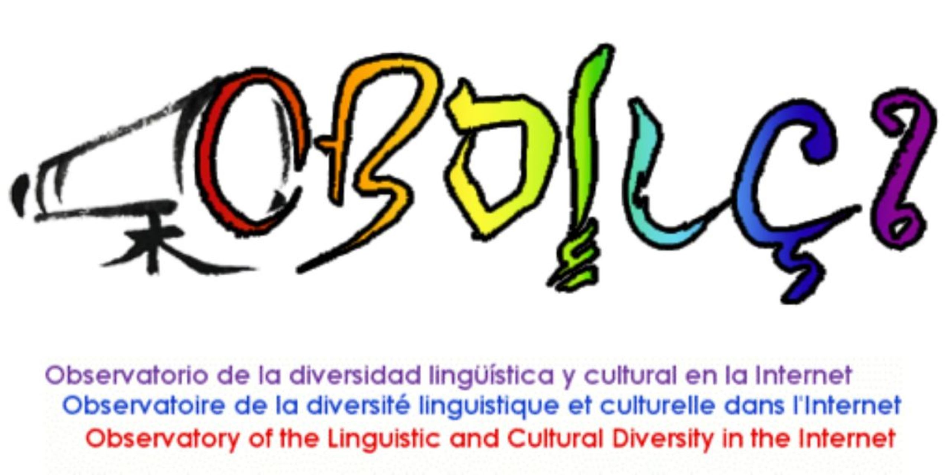
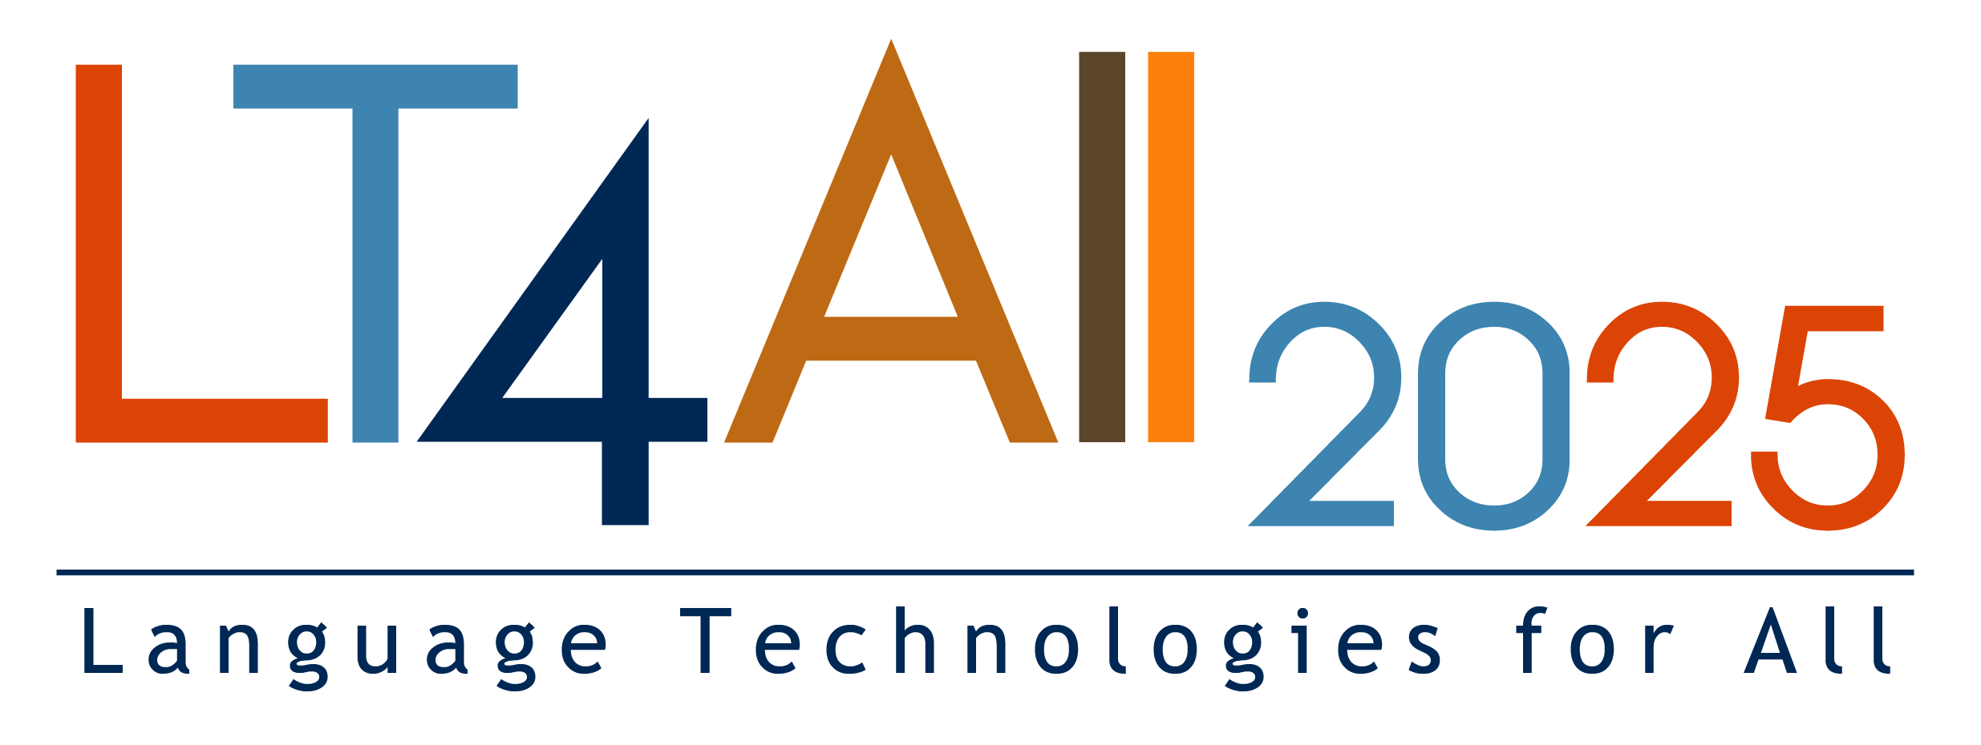
Session 5 Communication over Multilingualism: AI-based Translation vs Lingua Franca?
Daniel Pimienta - pimienta@funredes.org
Observatory of Linguistic and Cultural Diversity on the Internet - https://obdilci.org
Inventory and comparisons of all methods for the measure of languages online
and implications on Internet’s lingua franca

Slide 2
PLAYERS COMPARISON
 | W3TECHS | DATA PROVIDER | NET SWEEPER | IONAN UNIV. | OBDILCI MAIN | OBDILCI MECILDI
TYPE | COM | COM | COM | EDU | ORG | ORG
FREQUENCY | Daily (2011) | Once (2023) | Once (2023) | Once (2020) | Yearly (2017) | In plan (2025)
# LANG. | 40 | 107 | 47 | 1 | 361 | 141
SAMPLE | 1 M sites (TRANCO) | 99M Sites | 12B Pages | 0.1M | INDIRECT | TRANCO
PEER REVIEW | NO | NO | NO | YES | YES | WILL BE
BIAS Manag. | NO | NO | NO? | YES | YES | YES
BIAS | HUGE | HUGE BUT… | WEAK? | NO | WEAK | NO
DISCOVER | HUGE | MEDIUM | LOW | LOW | GROWING
USED | HUGE | NO | NO | NO | LOW
ENGLISH % | 58% | 51% | 26% | 28% | 20%
Multilingualism bias

Slide 3
(L1+L2)(English)@EU = 2x(L1+L2(English)@world)
W3TECHS 1/2023 | DATA PROVIDER 1/23 | NET SWEEPER 6/23 | IONAN Univ. 2020 | OBDILCI Main 5/2023 | MECILDI Pre-study 5/2024
57.7% | 51% | 26.3% | 28.4% | 20% | 29%
RAW DATA
28% | 25% | 26.3% | 15% ? | 20% | 29%
UNBIASED
SELECTION Tip of iceberg | SELECTION countries | SELECTION ??? | SELECTION EU ccTLD |  | SELECTION Tip of iceberg
REMAINING
BIAS
27% < ENGLISH@WEB < 20%
Unbias = bias / rate of multilingualism

Slide 4
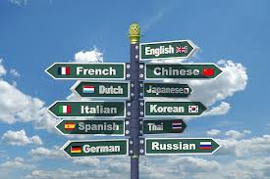
 | W3TECHS 11/2024 | DATAPROVIDER 1/23 | NETSWEEPER 6/23 | OBDILCI 5/2024
1 | English 49.4% | English 51.3% | English 26.3% | English 20.4%
2 | Spanish 6% | Chinese 10.3% | Chinese 19.8% | Chinese 18.9%
3 | German 5.6% | German 7.3% | Spanish 8.1% | Spanish 7.7%
4 | Japanese 5% | Spanish 3.9% | Arabic 5% | Hindi 3.8%
5 | French 4.4% | Japanese 3.7% | Portuguese 4% | Russian 3.7%
6 | Russian 4% | French 3.4% | Malay 3.4% | Arabic 3.7%
7 | Portuguese 3.8% | Russian 2.8% | French 3.3% | French 3.4%
8 | Italian 2.7% | Portuguese 2.7% | Japanese 3% | Portuguese 3.1%
9 | Dutch 2.1% | Dutch 2.0% | Russian 2.8% | Japanese 2.2%
10 | Polish 1.8% | Italian 1.9% | German 2.1% | German 2.2%
11 | Turkish |  | Korean | Malay
12 | Persian |  | Turkish | Bengali
13 | Chinese 1.2% |  | Italian | Turkish
14 | Vietnamese |  | Romanian | Italian
15 | Malay |  | Persian | Vietnamese

Slide 5
PLANS FOR 2025
Cooperation Dataprovider/Obdilci will offer a new results for the full set of websites (163 M)
with multilingualism bias removed.
MECILDI will offer Tranco based results without multilingualism bias.
The rate of multilingualism of the whole WWW and of Tranco will be revealed
A more precise percentage for English will be obtained, bewtween 20% and 27%
Chinese percentage around 20% will be confirmed or not
Obdilci model will be challenged or conforted.

Slide 6
SO WHAT?
Caution with data on the web without checking method and biases. Bet on peer-reviewed!
The multilingual nature of the Web cant be forgotten
English@web is half what media repeat not because it decreases but because more languages are coming
Why is Chinese contents are so underestimated by some methods when Chinese speakers are the most?
2025 will bring definitive light on those matters
The lingua franca of the Web is multilingualism boosted by AI powered translation

Slide 7
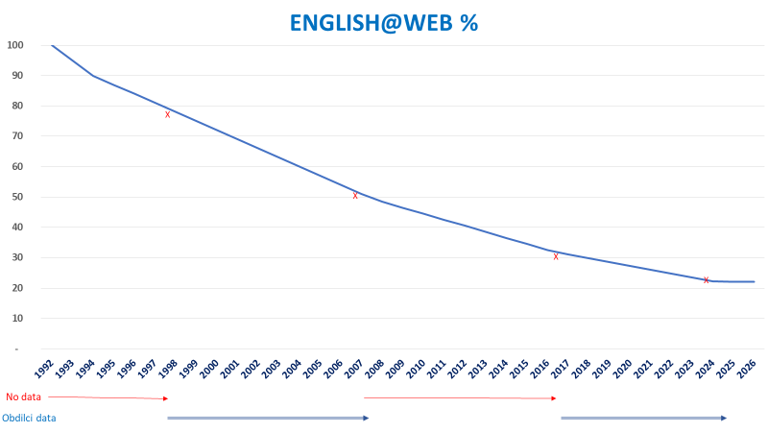
Source: OBDILCI

Slide 8
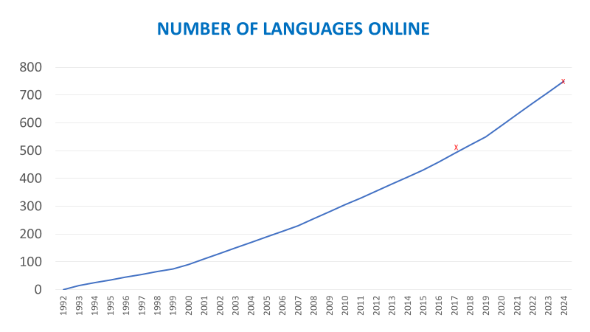
Source: Ethnologue dataset #27-2023
 | L1>1M | L1<1M | TOTAL
LANGUAGES % | 336 4.6% | 6 890 95.4% | 7 226 100%
L1 SPEAKERS % | 7 062 906 326 95.0% | 370 592 893 5% | 7 433 499 219 100%
L1+L2 SPEAKERS % | 10 303 359 711 96.1% | 421 864 047 3.9% | 10 725 223 758 100%
750
ENGLISH DOMINANCE EUROPEAN LANGUAGES ASIAN LANGUAGES AND ARABIC MULTILINGUALISM
Source: unicode

Slide 9
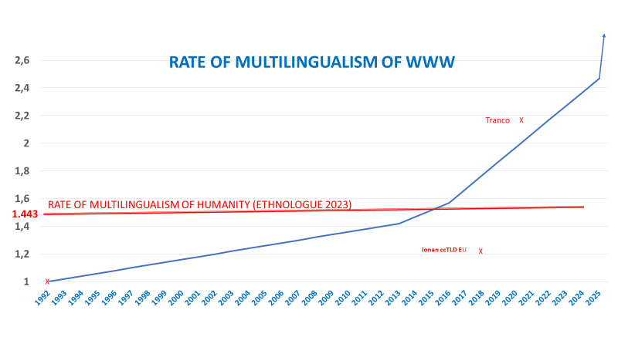
75% MONOLINGUAL
10% BILINGUAL
4% TRI-LINGUAL
10% > 3 WITH AVG = 11
Whole www
12% MULTILINGUAL
1.63 Rate
x
x
ccTLD EU
17% Multilingual
1.83 Rate
Source: OBDILCI

Slide 10
CONCLUSION 1: AI ASSISTED LANGUAGE TOOLS
AI represents a tremendous leap forward in the field of languages online.
Tasks that were once costly and difficult to implement are now accessible and inexpensive
Generating initial translations of documents without losing formatting
Creating multilingual versions of websites
Organizing videos on platforms with subtitles in many
Integrating automatic interpretation into online meetings platforms
Expanding these capabilities to face-to-face conferences
This the start of a deep paradigm shift for language’s online

Slide 11
CONCLUSION 2: AI ASSISTED LANGUAGE TOOLS
This shift occurs together the boost of multilingualism in the Web.
The lingua franca of the Internet is multilingualism boosted by AI based language tools

Slide 12
RECOMMENDED READINGS
ARCHEOLOGY : Pimienta, D., Prado, D., and Blanco, Á. (2009). Twelve Years of Measuring Linguistic Diversity on the Internet: Balance and Perspectives. Paris: UNESCO publications for the World Summit on the Information Society.
http://unesdoc.unesco.org/ulis/cgi-bin/ulis.pl?catno=187016
FIGURES : Pimienta, D. (2022). Resource: Indicators on the Presence of Languages in Internet, In Proceedings of the 1st Annual Meeting of the ELRA/ISCA Special Interest Group on Under-Resourced Languages, Marseille. European Language Resources Association. 83–91. https://aclanthology.org/2022.sigul-1.11/
METHOD: Pimienta, D., Müller de Oliveira, G., and Blanco, Á. (2023). The method behind the unprecedented production of indicators of the presence of languages in the Internet Front. Res. Metr. Anal., 17 May 2023 Sec. Research Methods Vol. 8
https://doi.org/10.3389/frma.2023.1149347
UNBIAS W3TECHS: Pimienta, D. (2024). Is it true that more than half the Web contents are in English? If Web multilingualism is paid due attention then no! Forum for Linguistic studies, Vol. 6 , Iss. 5
https://doi.org/10.30564/fls.v6i5.7144
THIS PAPER: Pimienta, D. (2025). Inventory and comparisons of all methods for the measure of languages online and implications on Internet lingua franca –
https://obdilci.org/wp-content/uploads/2025/01/LangOnlineReport.docx

Slide 13
FASTER READINGS
UNBIAS W3TECHS WEBPAGE: https://obdilci.org/projects/main/englishweb
THIS PRESENTATION WEBPAGE: https://obdilci.org/projects/main/methods
THIS PRESENTATION PPT: https://funredes.org/presentation/LT4ALL2025.pptx
FUTURE STUDIES : https://obdilci.org/projects/other/WebMultilinguism

